Slide 1
Wireless Building Power Monitor
(Hardware Design and Packaging)
2012 Spring to Summer
Pak Lam (Jack) Yung

Slide 2
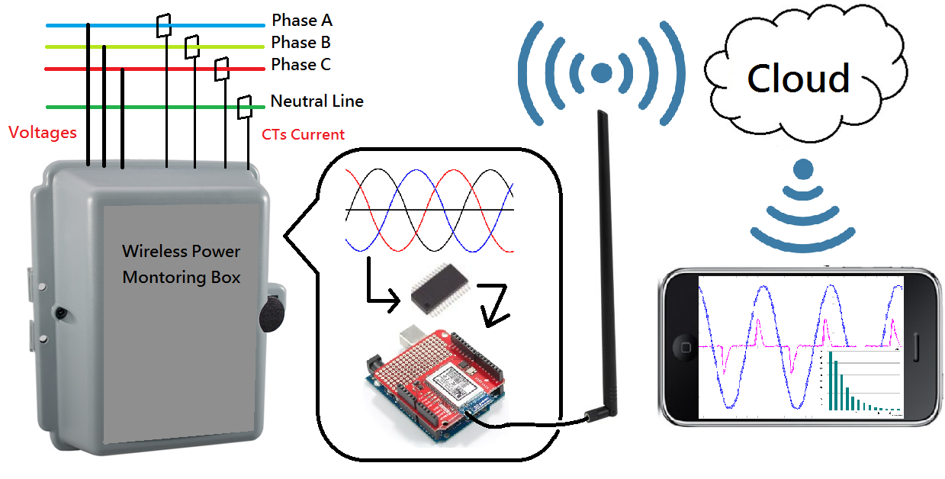
Wireless Power Monitor System

Slide 3
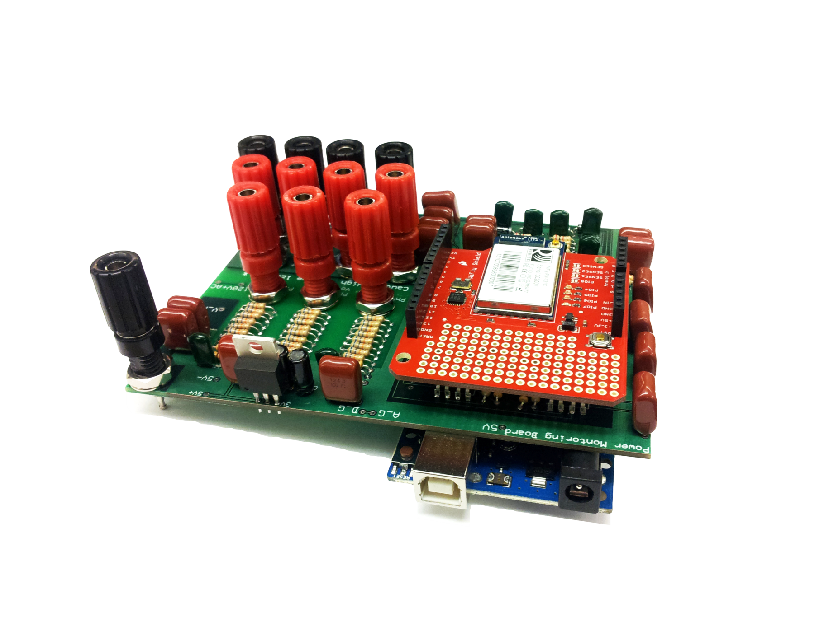
Inside the Box

Slide 4
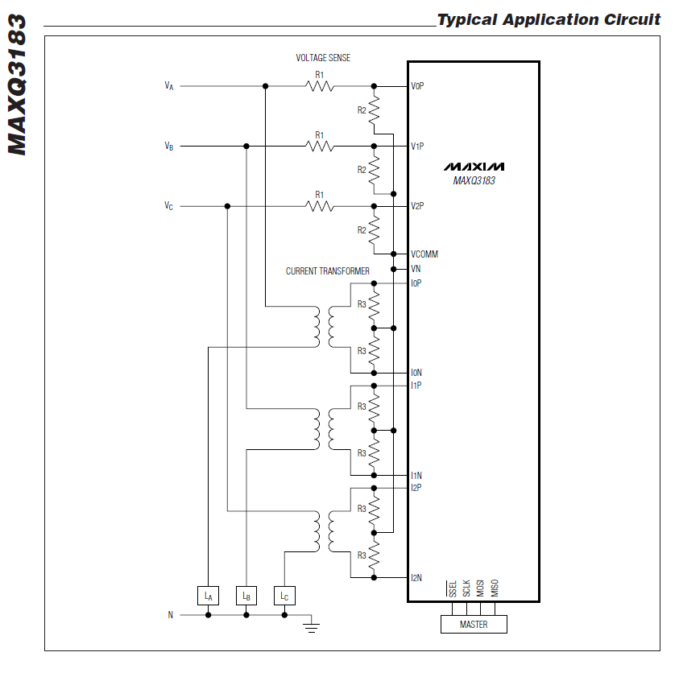

Slide 5
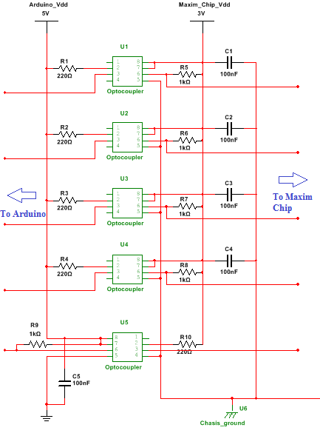

Slide 6
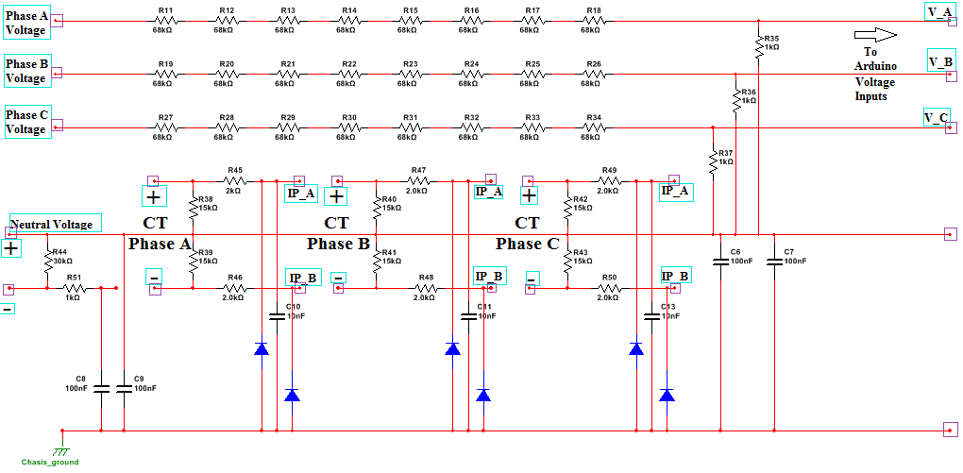

Slide 7
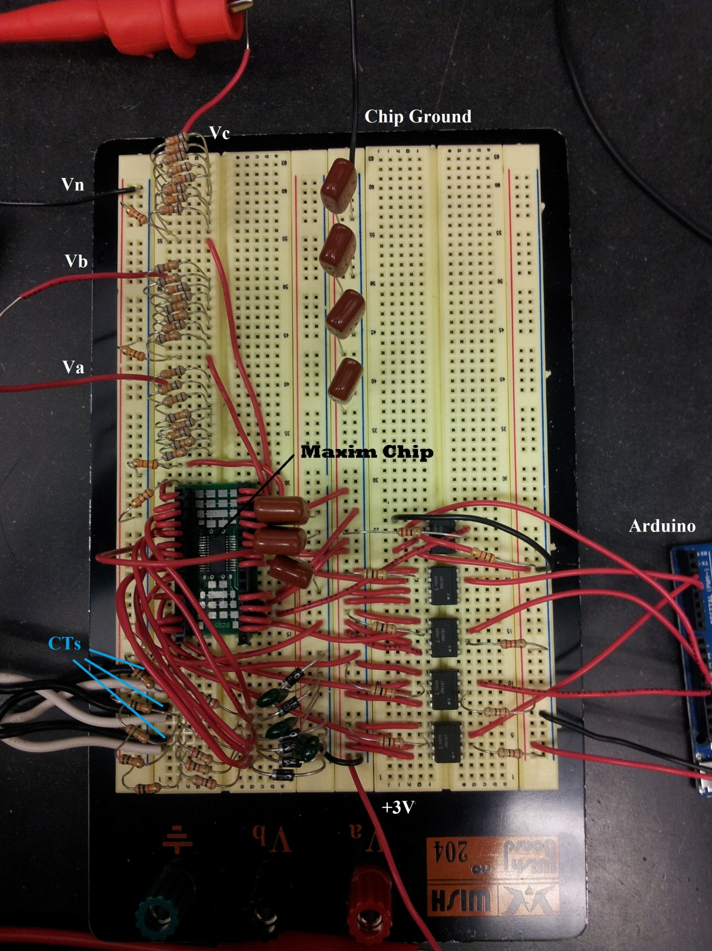

Slide 8
